Slide 1
Thailand Water Supply System Project
By:
Stephen Bonk
Joseph Moore
Kevin Dischino

Slide 2
Preliminary Site Assessment
Village of Hantham: subset of Longkhot, Thailand
Inadequate water supply during the dry season
159 Households and 453 People
Average Water Usage: 200 L/day per Household
Gathered Survey Data
Collected Soil Sample
Determined available resources

Slide 3
Survey Data

Slide 4
Design Goals
Supply entire village
Sustainably powered pumping system
Easily maintained and constructible Storage System
Distribution System
O & M Manual
Extremely Economical

Slide 5
Water Usage
Average Annual Flow is 200 L/day per Household
0.013 cfs for the total village
Total Storage Volume for 3 day supply = 3,369 cf
Maximum Hourly Flow per Year is 270% of Average Flow per Year
Maximum Hourly Flow per Year = 0.0351 cfs

Slide 6
Storage Tank Elevation

Slide 7
Storage Tank Elevation

Slide 8
Storage Tank Elevation
3 in Diameter for Pipe A
Site 1 and Site 2 Inadequate
Site 3 Adequate, No Tower Necessary
Place Storage Tanks at Site 3, Ground Level
Orange House Water Pressure will be 4 psi under Dynamic Conditions during Max Hour Flow

Slide 9
Pumping System
Submersible Pump
Pusher Pump
System Energy
Future Design Considerations
Manufacturer Specifications for Pumps
Solar Panel System Power Requirements

Slide 10
Water Distribution System Design

Slide 11
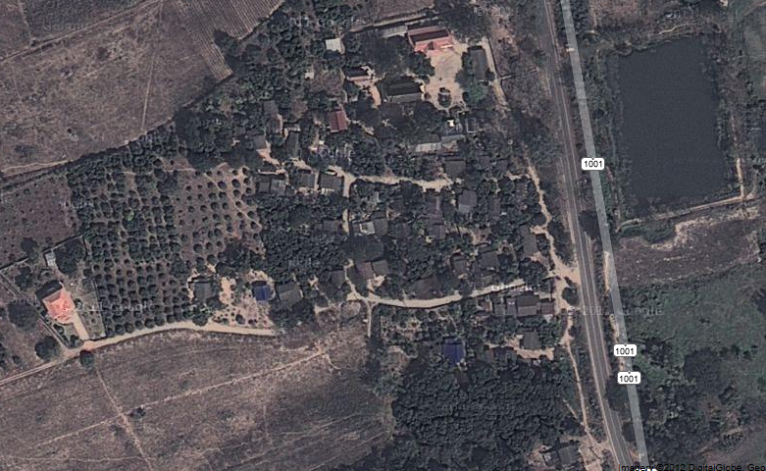

Slide 12
Process
Split Section A into Pipe Branches
Maximum Hourly Flow per Year:
2.207x10^-4 cfs for each household
Determine flow through each Pipe
Darcy – Weisbach Equation

Slide 13
Section A Schematic

Slide 14
Design of Pipe 1
Assume Maximum Velocity between 10-20ft/s
Find Minimum Diameter needed (A = Q/V)
For Pipe 1 of 13Q:
Diam = 0.16” – 0.23”
For 0.25” Diameter
Head Loss = 658 feet (Too Large)
For 1” Diameter – Head Loss = 0.98 feet
For 2” Diameter – Head Loss = 0.0242 feet

Slide 15
Total Headloss
1” Diameter – 3.025 feet
2” Diameter – 0.079 feet
In the Future…
Will be Utilizing WaterCAD to analyze entire village

Slide 16
Foundation
Soil Profile
γ=105 pcf φ = 30º c = 0 psf (Normally Consolidated Soil)
Soil Classification
USCS: Silty or Clayey Sand
Minimum soil characteristics
γ= 80 pcf φ= 28º c = 0 psf
Bearing capacity: Min=4000 psf, Estimated=13000 psf
Factor of Safety: Estimated=16.1, Min=4.75

Slide 17
Water Tank Design
Type
Reinforced Concrete Rectangular Tank (25’x25’x6’)
Fiberglass or Reinforced Concrete Circular Tank ( Dia.=18’)
12” thickness of wall and 8” slab.
Availability
Reinforced Concrete only available, no fiberglass
Cover: Reinforced Concrete or Sheet Metal
Placement: Site 3
Construction Time

Slide 18
Budget
Material Cost
Pumping System $6,500
Reinforced Concrete Tank $8,000
Travel Cost
$2,500 per person

Slide 19
Gantt Chart

Slide 20
Questions or Concerns?

