Slide 1
Thailand Water Supply System Project
By:
Stephen Bonk (Team Leader)
Kevin Dischino
Joseph Moore

Slide 2
Preliminary Site Assessment
Village of Hantham: subset of Longkhot, Thailand
Inadequate water supply during the dry season
159 Households and 453 People
Average Water Usage: 200 L/day per Household
Gathered Survey Data
Collected Soil Sample
Determined available resources

Slide 3
Survey Data

Slide 4
Design Goals
Supply entire village
Sustainably powered pumping system
Easily maintained and constructible Storage System
Distribution System
O & M Manual
Extremely Economical

Slide 5
Water Resources and Hydraulics Design

Slide 6
Water Usage
Average Annual Water Usage is 200 L/day per Household
Total Village Usage is 1,123 cf/day
Total Tank Volume for 3 day supply = 3,369 cf
Maximum Hourly Flow per Year is 270% of Average Flow per Year
Maximum Hourly Flow per Year = 0.0351 cfs

Slide 7
Minimum Storage Tank Elevation
Must provide adequate water pressure for highest household in the village
Is structure required to provide additional elevation?

Slide 8
Minimum Storage Tank Elevation

Slide 9
Minimum Storage Tank Elevation

Slide 10
Minimum Storage Tank Elevation
Major Head Loss in Pipe A:
1 in Diameter → Major Head Loss = 323.5 ft
2 in Diameter → Major Head Loss = 11.7 ft
3 in Diameter → Major Head Loss = 1.7 ft
Minimum Diameter of Pipe A for Maximum Velocity of 10 fps = 0.8 in
3 in Diameter Pipe Selected

Slide 11
Minimum Storage Tank Elevation
Using 3 in Diameter Pipe A
Site 1 and Site 2 Inadequate
Site 3 Adequate, No Tower Necessary
Place Storage Tanks at Site 3, Ground Level
Orange House Water Pressure will be 4 psi under Dynamic Conditions during Max Hour Flow

Slide 12
Pumping System
Submersible Pump
Pusher Pump
System Energy

Slide 13
Pumping System

Slide 14
Pump System
Future Design Considerations
Manufacturer Specifications for Pumps
Solar Panel System Power Requirements
Tank Level Switch

Slide 15
Water Distribution System Design

Slide 16
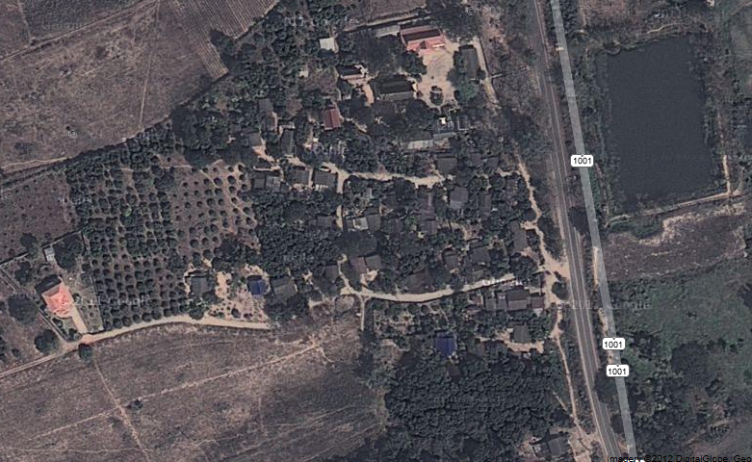
Site View

Slide 17
Process
Split Section A into Pipe Branches
Maximum Hourly Flow per Year:
2.207x10^-4 cfs for each household
Determine flow through each Pipe
Darcy – Weisbach Equation
Reynold’s Number, ε/D
Use of WaterCAD

Slide 18
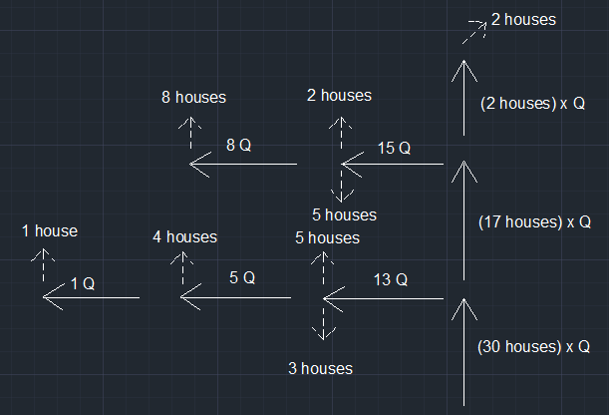
Section A Schematic
Pipe 7 = 275 ft.
Pipe 6
250 ft.
Pipe 5
350 ft.
Pipe 4 = 200 ft.
Pipe 3
200 ft.
Pipe 2
320 ft.
Pipe 1 445 ft.

Slide 19
Design of Pipe 1
Assume Maximum Velocity between 10-20ft/s
Find Minimum Diameter needed (A = Q/V)
For Pipe 1 of 13Q:
Diameter = 0.16” – 0.23”
For 0.25” Diameter
Head Loss = 658 feet (Too Large)
For 1” Diameter – Head Loss = 0.98 feet
For 2” Diameter – Head Loss = 0.0242 feet

Slide 20
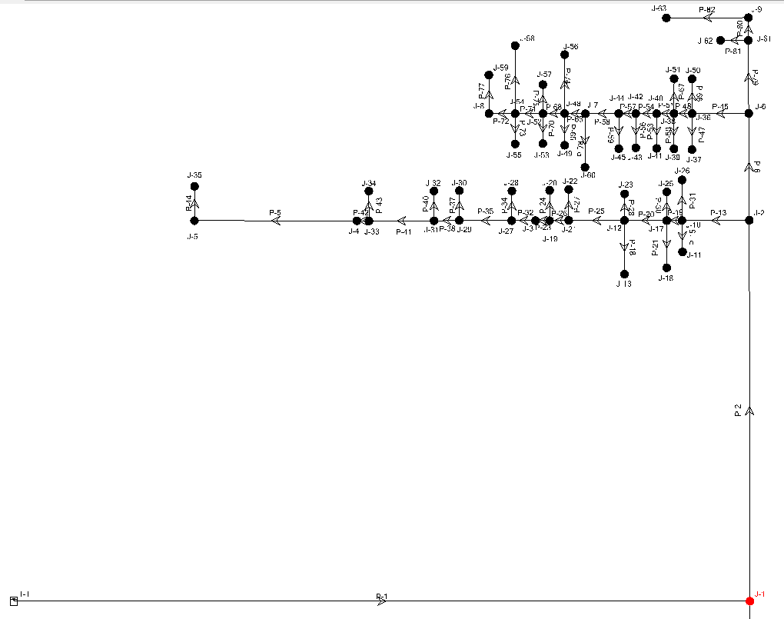
WaterCAD Schematic

Slide 21
Input / Output

Slide 22
Total Head Loss
Hand Calculations
1” Diameter – 3.025 feet
2” Diameter – 0.079 feet
WaterCAD Results
2” Diameter – 0.0665 ft.

Slide 23
WaterCAD Output
Pipe | Start Node | Stop Node | Diameter (in) | Material | Flow (cfs) | Headloss Gradient (ft/ft) | Length (ft) | Headloss (ft)
P-1 | T-1 | J-1 | 3 | PVC | 0.035091 | 0.000867 | 1,903 | 1.649901
P-2 | J-1 | J-2 | 4 | PVC | 0.006621 | 0.000008 | 853 | 0.006824
P-5 | J-4 | J-5 | 2 | PVC | 0.000221 | 0.000004 | 200 | 0.0008
P-6 | J-2 | J-6 | 2 | PVC | 0.003752 | 0.000083 | 200 | 0.0166
P-13 | J-2 | J-10 | 2 | PVC | 0.002869 | 0.000052 | 150 | 0.0078
P-15 | J-10 | J-11 | 0.75 | PVC | 0.000221 | 0.000198 | 25 | 0.00495
P-18 | J-12 | J-13 | 0.75 | PVC | 0.000221 | 0.000198 | 100 | 0.0198
P-19 | J-10 | J-17 | 2 | PVC | 0.002428 | 0.000046 | 30 | 0.00138
P-20 | J-17 | J-12 | 2 | PVC | 0.001986 | 0.000036 | 85 | 0.00306
P-21 | J-17 | J-18 | 0.75 | PVC | 0.000221 | 0.000198 | 80 | 0.01584
P-23 | J-19 | J-3 | 2 | PVC | 0.001104 | 0.00002 | 25 | 0.0005
P-24 | J-19 | J-20 | 0.75 | PVC | 0.000221 | 0.000202 | 25 | 0.00505
P-25 | J-12 | J-21 | 2 | PVC | 0.001545 | 0.000028 | 115 | 0.00322
P-26 | J-21 | J-19 | 2 | PVC | 0.001324 | 0.000024 | 40 | 0.00096

Slide 24
Geotechnical and Storage Tank Design

Slide 25
Foundation
Soil Profile
γ=105 pcf φ = 30º c = 0 psf (Normally Consolidated Soil)
Soil Classification
USCS: Silty or Clayey Sand
Minimum soil characteristics
γ= 80 pcf φ= 28º c = 0 psf
Bearing capacity: Min=3855.9 psf, Estimated=13062.84 psf
Factor of Safety: Estimated=16.09, Min=4.75

Slide 26
Soil Properties

Slide 27
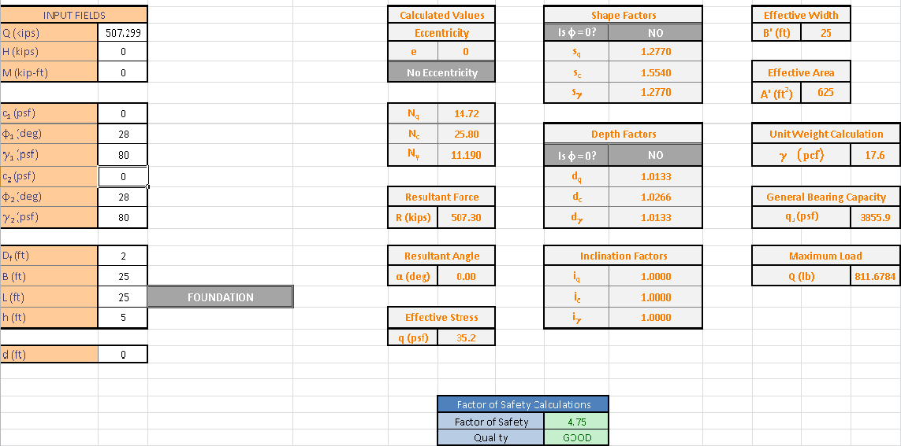
Foundation Spreadsheet

Slide 28
Water Tank Design
Type
Reinforced Concrete Rectangular Tank (25’x25’x6’)
Fiberglass or Reinforced Concrete Circular Tank ( Dia.=18’)
12” thickness of wall and 8” slab.
Formwork
Availability
Reinforced Concrete only available, no fiberglass
Cover: Reinforced Concrete or Sheet Metal
Placement: Site 3
Construction Time

Slide 29
Rectangular Cantilever Concrete Tank
Height: 6 feet
Depth of Embedment: 2 feet
Top of Wall: 8” Concrete
Heel and Toe slab use same reinforcement
Water Stirrup (Rubber)

Slide 30
Rectangular Cantilever Storage Tank

Slide 31
Gantt Chart

Slide 32
Budget

Slide 33
Questions?

